Slide 1
Hematopoietic cell transplantation (HCT)
Def: the administration of hematopoietic stem cells from any source (ex: bone marrow, peripheral blood, umbilical cord blood) to reconstitute the bone marrow.

Slide 2
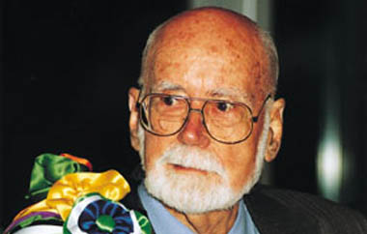
The Nobel Prize, 1990
E. Donnall Thomas
first succsessful HSCT in treatment of acute leukemias
Thomas ED, Lochte HL, Lu WC, Ferrebee JW. Intravenous infusion of bone marrow in patients receiving radiation and chemotherapy. N. Engl. J. Med. 1957; 257: 491.

Slide 3
Hematopoietic Stem cells (HSC)
Cells produced in bone marrow that gives rise to all other blood cells (WBCs, RBCs, and platelets).
comprise only 0.01% of the total marrow cells
Replenishes itself
Relatively resistant to injury
⃰ can be eliminated with high doses of chemotherapy or radiation therapy

Slide 4
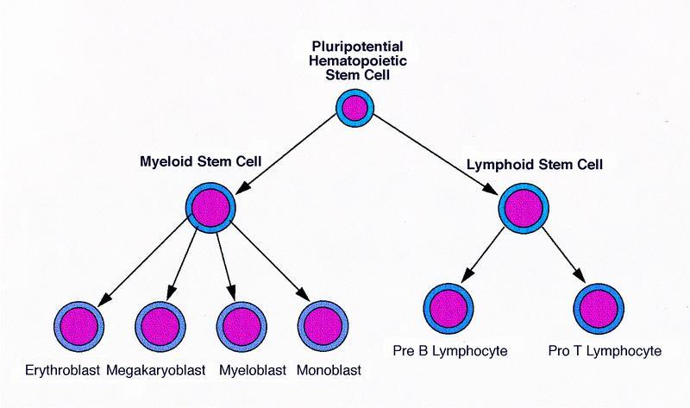

Slide 5
Hematopoietic Stem cells (HSC)
Allogeneic
Syngeneic
Autologous

Slide 6
Allogeneic HCT
HSC collected from a donor
either a related donor (usually an HLA-identical sibling) or a closely HLA-matched volunteer unrelated donor (VUD).
These grafts are free of tumor, but may be associated with potentially detrimental GVHD as well as a potentially beneficial graft-versus-tumor effect.
The period of pancytopenia following HCT is longer than for autologous HCT, and immunosuppressive agents are required for prophylaxis against and treatment of GVHD

Slide 7
Autologous HSCT
The patient’s own stem cells from blood or marrow are collected before the introduction of chemotherapy and stored in the vapour phase of liquid nitrogen until required.
The patient's hematopoietic stem cells rescues the patient from long-lasting, usually irreversible, profound pancytopenia
There is no risk of GVHD and no immunosuppression is required.

Slide 8
These stem cells engraft more quickly, marrow recovery occurring within 2–3 weeks
There is a higher rate of recurrence of malignancy because the anti-malignancy effect is solely dependent on the conditioning chemotherapy with no ‘graft-versus-disease’ effect
The most common indications are lymphomas and myeloma
The preferred source of stem cells for autologous transplants is peripheral blood (PBSCT).

Slide 9
Syngeneic HCT
hematopoietic stem cells come from an identical twin
Syngeneic donors offer the advantage of providing a graft that is free of tumour cells and is only associated with a minimal risk of GVHD

Slide 10
Bone marrow conditioning ???
Is the preparation of the patient bone marrow to the HSCT

Slide 11
The preparative or conditioning regimen is a critical element in the hematopoietic cell transplant procedure The purposes of the which are:
To provide adequate immunosuppression to prevent rejection of the transplanted graft
To eradicate the disease for which the transplant is being performed

Slide 12
The conditioning treatment (chemotherapy with or without radiotherapy) is ‘myeloablative’ or, increasingly, ‘nonmyeloablative’
Myeloablative conditioning
destroys malignant cells
immunosuppresses the recipient
ablating the recipient’s haematopoietic tissues
Non-myeloablative
relies on intense immunosuppression to provide ‘immunological space’ for transplanted stem cells

Slide 13
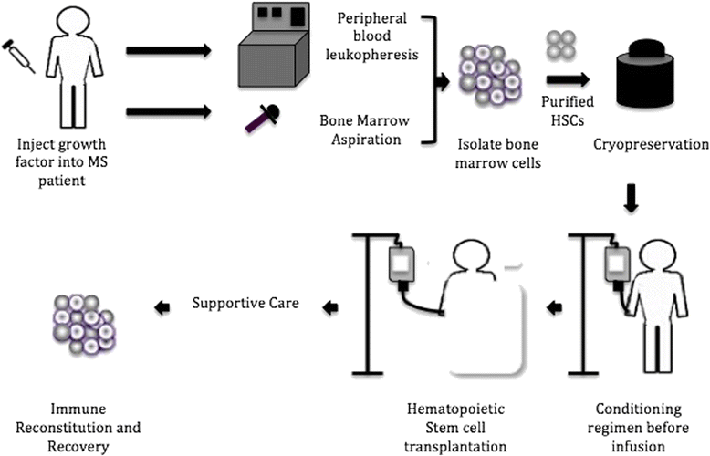

Slide 14
About 3–4 weeks are needed to produce enough erythrocytes, granulocytes and platelets for the patient’s
During this period of aplasia, patients are at risk of infection and bleeding

Slide 15
Indication for HSCT
Neoplastic disorders
Hematological malignancies
Lymphomas (Hodgkin and non-Hodgkin)
Leukemias (acute and chronic)
Multiple myeloma
Mmyelodysplastic syndrome
Solid tumors
Non-neoplastic disorders
Aplastic anemia
Autoimmune diseases
Immunodeficiency
Inborn errors of metabolism

Slide 16
Complications of allogeneic haematopoietic stem cell transplantation
Early
Anaemia
Infections
Bleeding
Acute GVHD
Mucositis – pain, nausea,
diarrhoea
Liver veno-occlusive disease
Late
Chronic GVHD
Infertility
Cataracts
Second malignancy

Slide 17
Infections during recovery from haematopoietic stem cell transplantation (HSCT)
Infection | Time after HSCT | Management
Herpes simplex | 0–4 weeks (aplastic phase) | Acyclovir prophylaxis and therapy
Cytomegalovirus | 5–21 weeks (cell-mediated immune deficiency) | Antigen screening in blood (PCR) and pre-emptive therapy e.g. (ganciclovir)
Varicella zoster | After 13 weeks | Acyclovir prophylaxis and therapy
Pneumocystis jirovecii | 8–26 weeks | Co-trimoxazole
Encapsulated bacteria Streptococcus pneumoniae; Haemophilus influenzae type B (B polysaccharide); Neisseria meningitidis; Klebsiella pneumoniae; Salmonella typhi; Pseudomonas aeruginosa; Cryptococcus neoformans. | 8 weeks to years (immunoglobulin deficiency, prolonged with GVHD) | Prophylaxis and revaccination

Slide 18
Graft-versus-host disease
GVHD is caused by the cytotoxic activity of donor T lymphocytes that become sensitised to their new host, regarding it as foreign.
acute or a chronic form of GVHD.
Acute GVHD occurs in the first 100 days after transplant in 1/3 patients.
It can affect the skin - rashes,
the liver - jaundice
the GIT - diarrhoea
vary from mild to lethal.

Slide 19
Prevention of GVHD:
HLA-matching of the donor
immunosuppressant drugs, including methotrexate, ciclosporin, alemtuzumab or Anti-thymocyte globulin (ATG)
Treatment of acute GVHD
Is difficult, despite high-dose glucocorticoids, may result in death

Slide 20
Chronic GVHD
Follow acute GVHD or arise independently
It often resembles a connective tissue disorder, although in mild cases a rash may be the only manifestation
assoc. with increased infection risk
Treatment:
glucocorticoids
prolonged immunosuppression ex: ciclosporin.

Slide 21
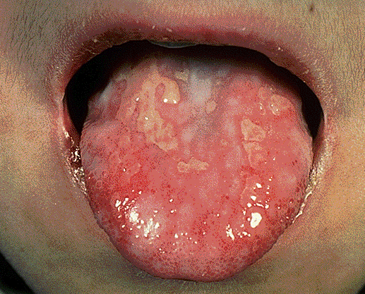
Graft versus host disease (GVHD)

